Slide 1

Sarvajanik Education Society Sarvajanik College of Engineering & Technology, Surat. Master in Computer Applications Department A Project On “Rental Management System ” Presented By Nenshi Patel(205310694016) MCA II Sem. 4 Under The Guidance of Dr. kaushika Pal

Slide 2

Company Profile
La Net Team Software Solutions is an offshore outsourcing software development company in India.
La Net Team is a software outsourcing company that focuses on highly qualitative, timely delivered and cost effective offshore software development services to its clients.
La Net Team provides a quality driven approach towards software development and provides end-to-end customized solutions catering to the requirements. Each of our professionals is experienced, detail oriented Senior Software Engineer with strong problem solving, communication and project management skills.

Slide 3
Learning Technologies
Java Script
Advance Java Script (Es6)
Git Hub
Node Js
Demo project on Node Js (Demo => Blog API with Mongo Db)
Angular
Demo project on Angular / Demo => Recipe Book

Slide 4

Rental Management System
Register User
Login User
Add Own Property
View Own Property
View Other’s Property for Rent
Houses – Vacant / Occupied
View Detail f Property
Sorting By Area , price , No of BadRoom , No of BathRoom
Search By Locations
Feedback
Searching
Features of Applications

Slide 5
System Description
In Rental System users can Register And login.
House type : Vacant / Occupied
User Add their own property for rent as well as see property of Other users.
Users/Tenant can view by the location(like State and City wise). Also add their property for rent.
User can view detail of the different houses.
Sorting on Different Attribute like Price , Area , No of Bedroom , No of Bathroom.
Searching on property.

Slide 6
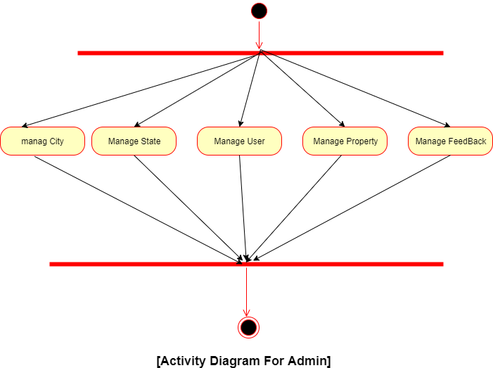
Diagrams
Activity Diagrams

Slide 7
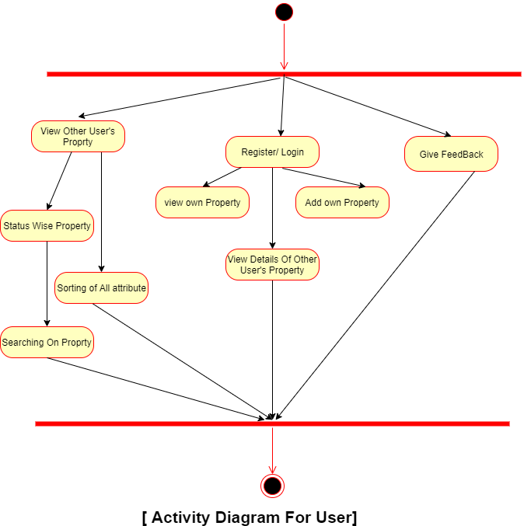

Slide 8
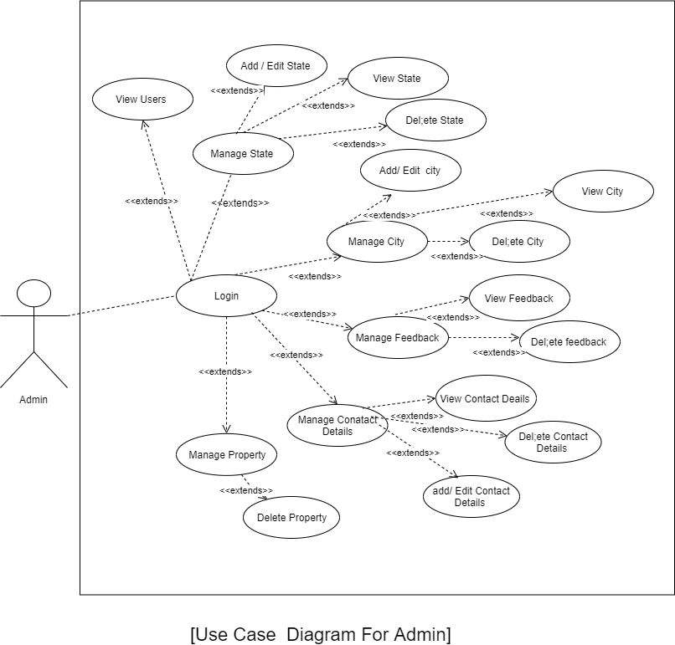
UseCase Diagram

Slide 9
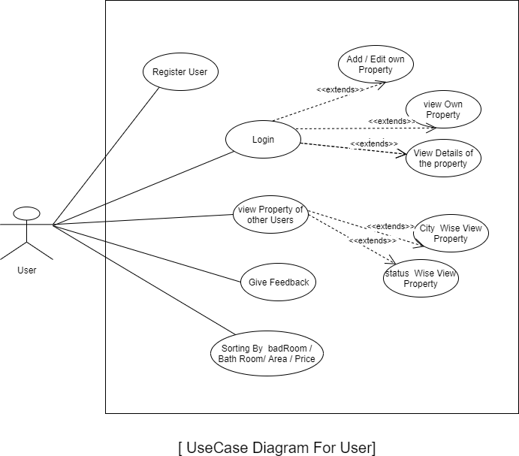

Slide 10
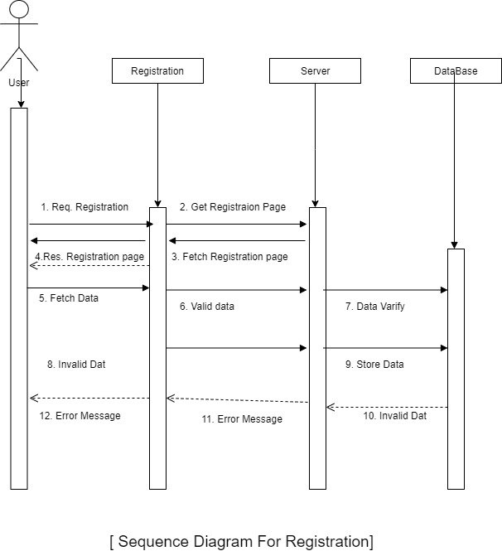
Sequence Diagram

Slide 11
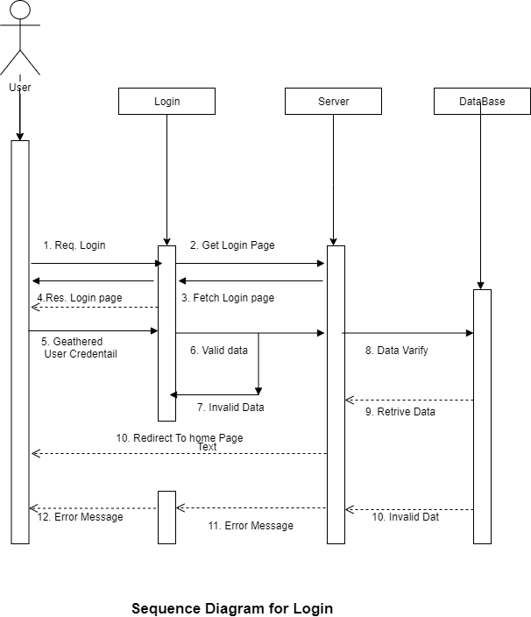

Slide 12
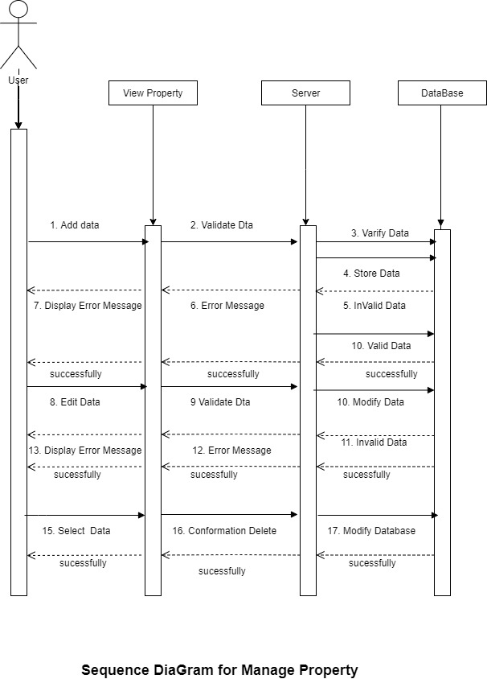

Slide 13
Screen Shots

Slide 14
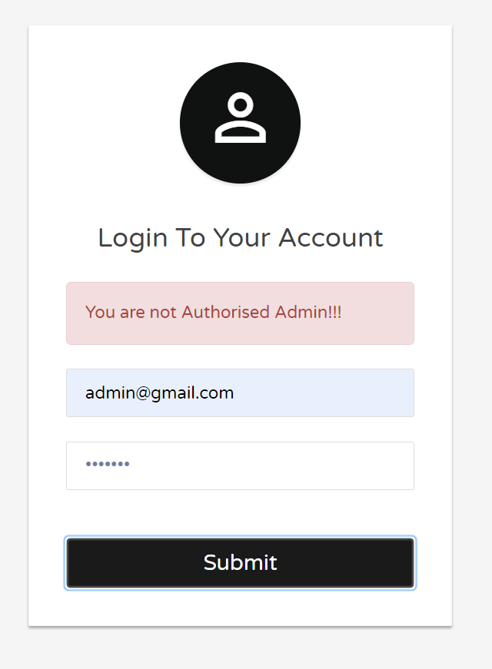
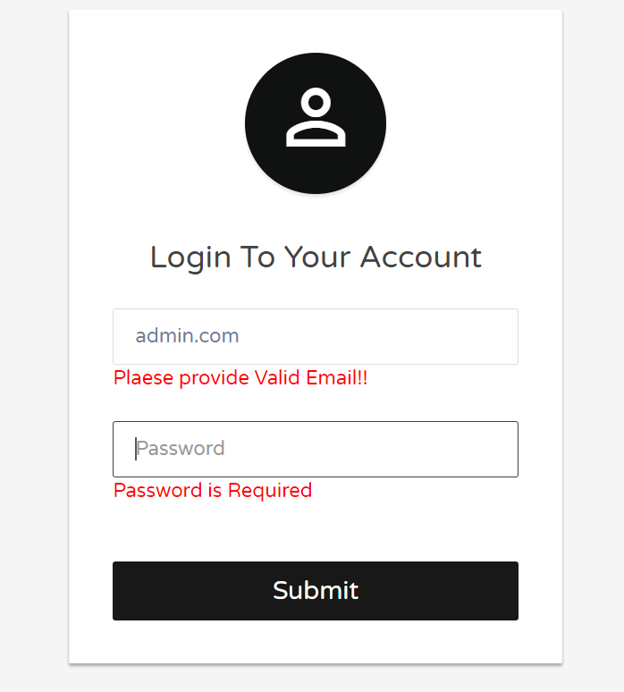
Admin side

Slide 15
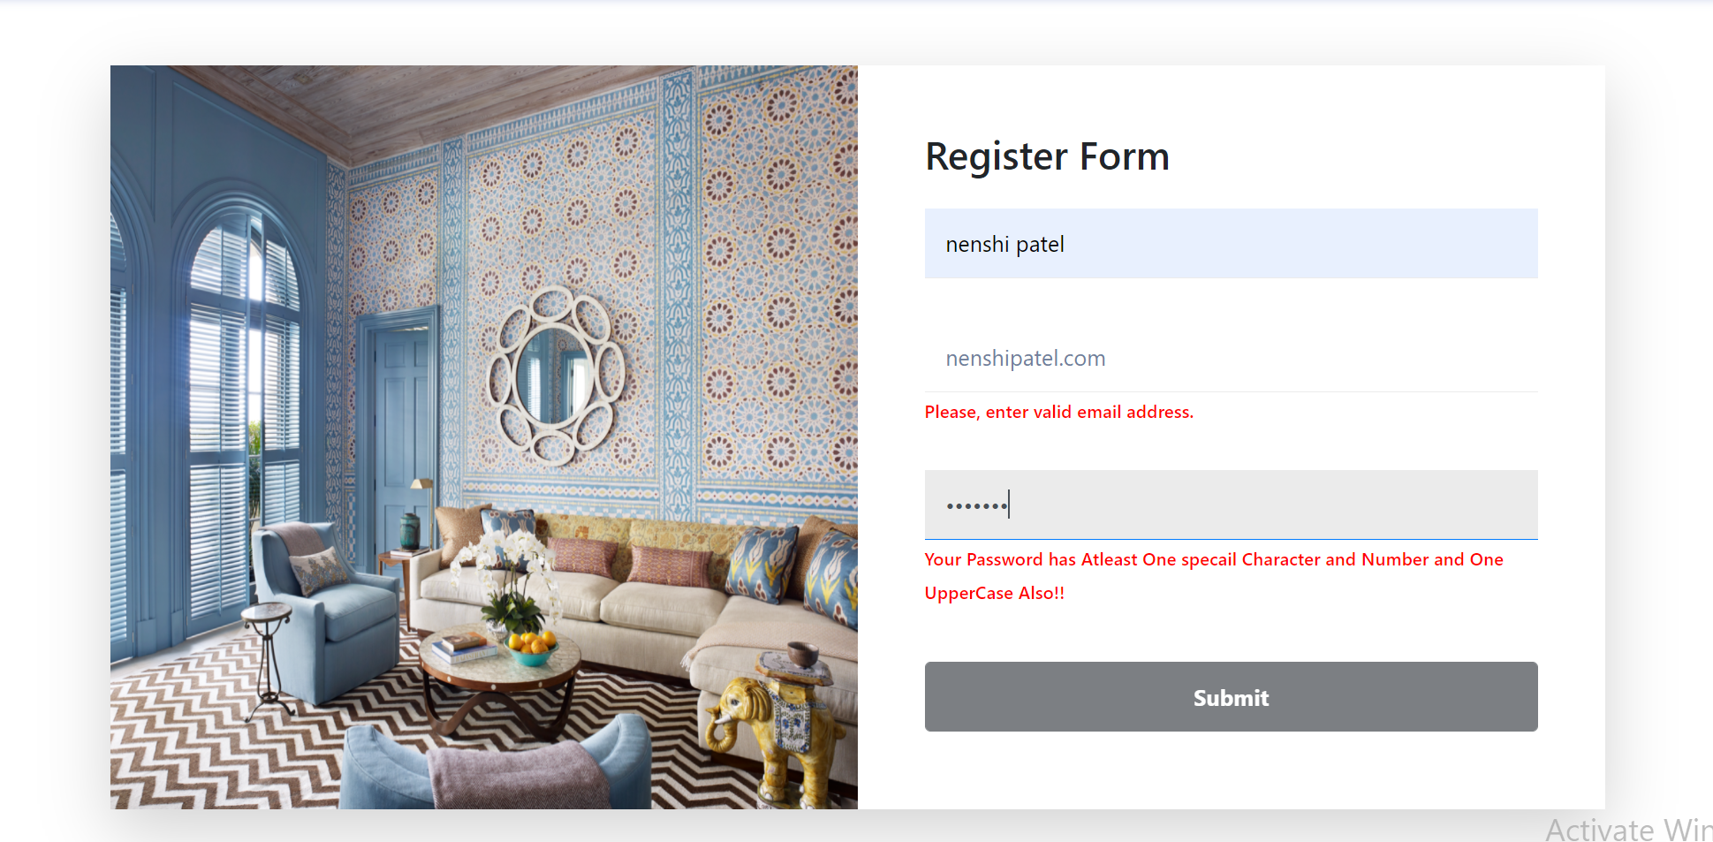
User Pannel

Slide 16
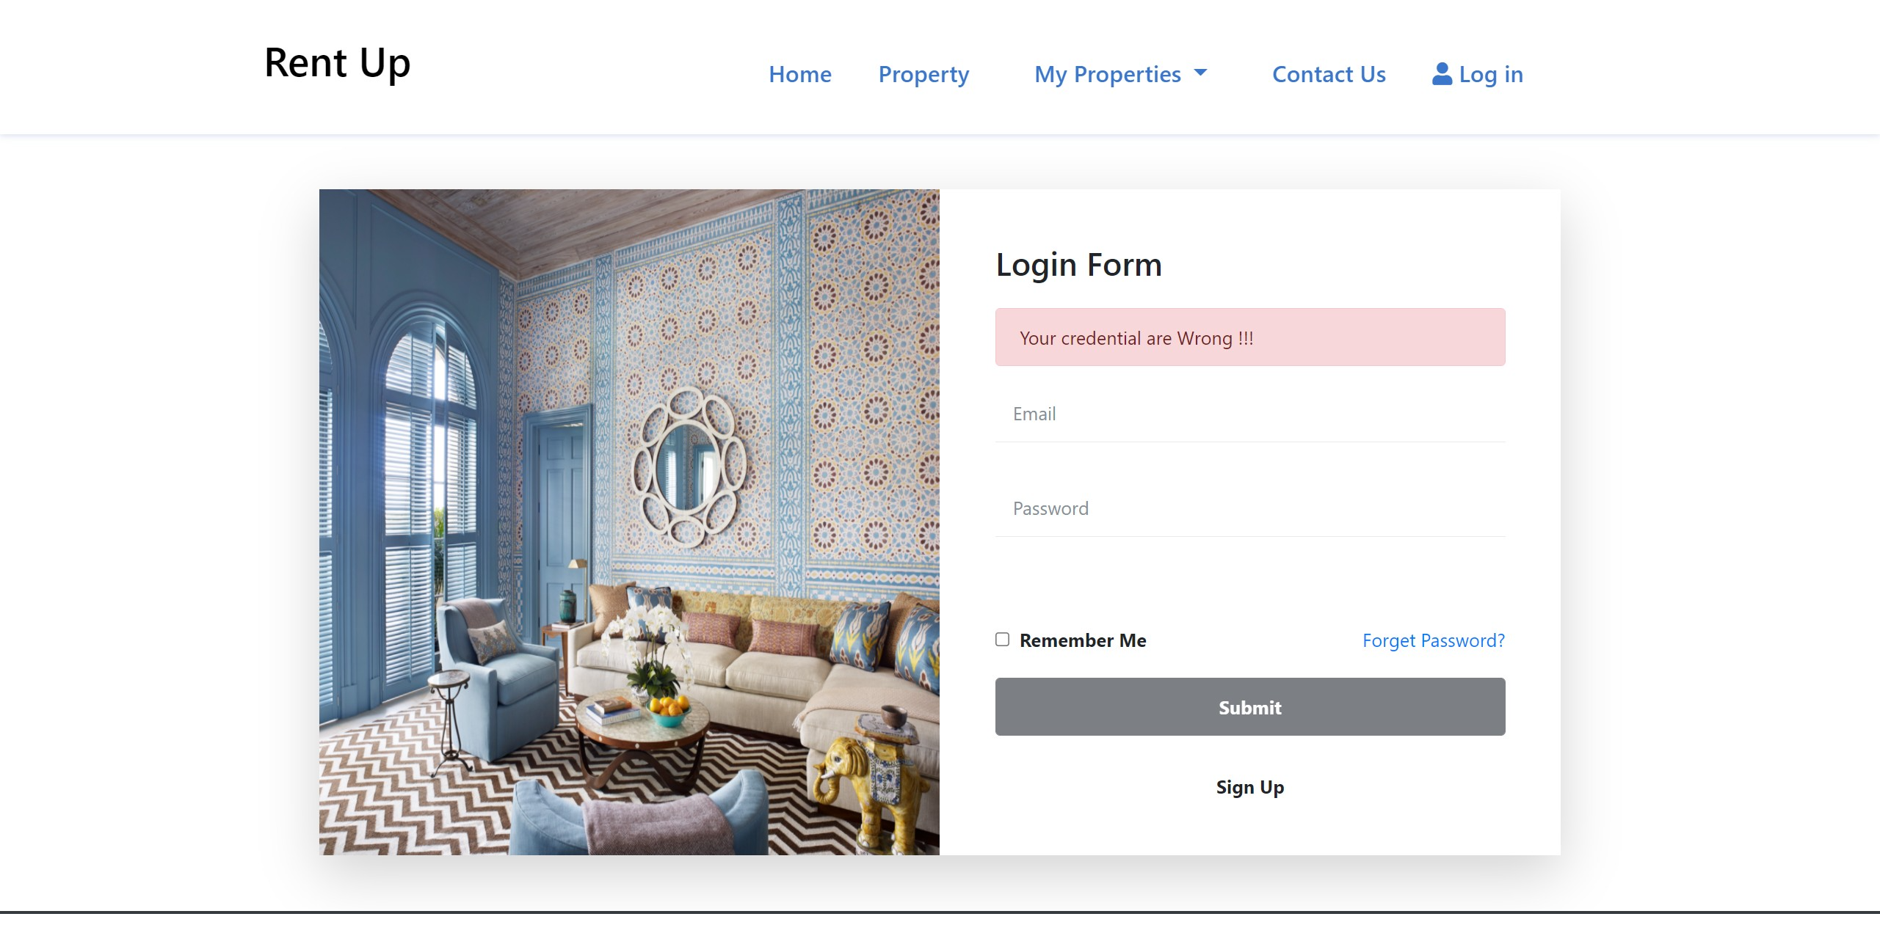

Slide 17
Thank You!

